Slide 1
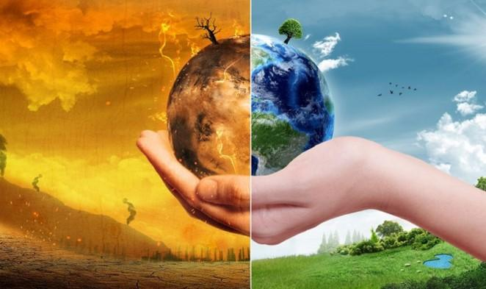
BSMM 8750
Pred. Modelling & Decision Making
Climate Action
Group 01
Prof. Manjari Maheshwari
Ank Tiwari (110063580)
Karan Kaushik Dave (110073307)
Meet Patel (110063753)
Shivam Goyal (110069267)
Syed Hassan (110066217)
Zain Haider (110063040)

Slide 2

AGENDA
1
What is happening ?
2
Drivers of Climate Change
3
Steps taken to combat Climate Change

Slide 3






Background & Introduction a
Urgent actions are required to combat climate changes and its impacts
Climate Action is the need of the hour
2019 was the second warmest year on record
Weather patterns are changing across the world
Individual lives is being affected
One Planet, One Chance, Let’s save it!

Slide 4



Dataset Information
There are more than 10 datasets in total and were found and collected from the World Bank, IMF, and OECD which is a subsidiary organization of the World Bank
The 10 datasets altogether have more than 50 columns which we must analyze. It has Mean surface temperature change, Sea level rise, drivers behind GHG and CO2 along with many other related factors
We are working on Climate change at the world level and comparing it with Canada, hence it includes all the countries
Data Source:
Nasa – Global Climate Change

Slide 5
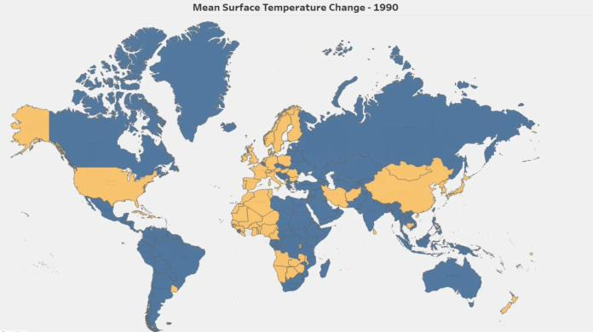



Climate Action – Need of the hour
Mother Earth is
BURNING
Avg. Surface Temperature rose by 1.5°C since last 5 years
Canada, among top 5 countries with highest temperature rise
The last five years have been the warmest across the entirety of recorded human history worldwide
Data Source:
Nasa – Global Climate Change

Slide 6

Climate Action – Need of the hour
Oceans
are bearing the heat
Greenland Ice is melting
Antarctic Ice is melting
200
263
151
45%
ZJ Change in ocean heat from 1992 to 2020
billion metric tons per year since 2015
billion metric tons per year since 2015
Increase in the sea level since 2015
Data Source: IMF, NASA & EPA(US Environmental Protection Agency)

Slide 7




Climate Action – Need of the hour
Temperature Rise causing
Extreme Weather
2,374
141.5M
6,630
76%
Climatic Disasters from 2015 - 2021
Increase in Floods since 2015
People displaced globally due to Storms & Floods from 2015 - 2021
People displaced in Canada due to Extreme temperature from 2015 - 2021
Data Source: IMF and Our World in data

Slide 8


Climate Action – Need of the hour
What’s really
Warming the Earth?
6.8%
64%
Increase in GHG Emissions from 2020 to 2021
World’s electricity was generated from fossil fuels from 2015 - 2021
Data Source: World Bank and Our world in data

Slide 9


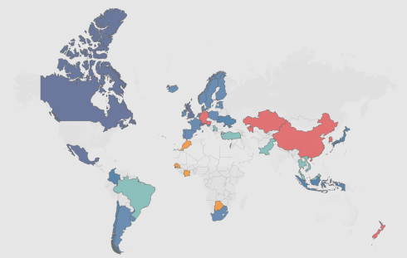

Climate Action – Need of the hour
Global Measures to combat climate change
11.83
46
29-32
1.5˚C
GtCO2e, representing 23.11% of global GHG emissions covered these initiatives in 2022
GT CO₂e reduction
across six-sectors
National jurisdictions are covered by the initiatives selected
limit temperature rise
Emerging carbon pricing initiatives around the world
Data Source: UN Environment Program

Slide 10



Climate Action – Need of the hour
How has Canada progressed ?
66 Mt
>10 %
16 %
Reduction in total GHG emission from 2019 - 2020
Reduction in total GHG emission in 5 provinces from 2019 - 2020
Reduction in total GHG emission in Transport sector 2019 - 2020
Fuel Charge & Output-Based Carbon Pricing System Policies
Provincial Policies
Federal Policies
Both Policies

Slide 11





Can we make a difference ?
Yes we can!!!
This can play a huge role in limiting the Earth's Temperature rise to 1.5°C
Save Energy at Home
can reduce 900 kilograms of CO2e per year
Walk, Bike, Public Transport
can reduce 2 tons of CO2e per year
Reduce, Reuse & Recycle
can reduce 17 kilogram of CO2e per year
Raise awareness
Climate action is a task for all of us

Slide 12
Thank you!

